Slide 1
BU Law | Chinese and Korean Race-Based Algorithm
Team 1
Aditya Agrawal
Cindy Lu
Leon Zhang
Melissa Zhen
Sponsor
BU School of Law
Project Goal: Collect and analyze data to identify the distribution of Chinese and Korean inventors by gender. We also want to analyze the difference in gender analysis when analyzing characters instead of US translated names.
Notes:
Project Title, Sponsor, Team Members
Project motivation:
What is the goal of the project?
What is the background needed to understand the project?

Slide 2
Patents and Names Extraction
Used Spring 2022 Team 1’s data (years 2017-2021)
We collected 38,452 for 2017, 38,768 for 2018, 50,960 for 2019, 55,183 for 2020 and 48,597 for 2021
Challenges
Large runtime to extract original names
As a result, we only used data from the years 2017-2021
A lot of gender prediction for English Names are unknown or androgynous
Notes:
What data have you used? If you collected data, how did you do that?
What challenges did you encounter working with data?

Slide 3
Gender Prediction Methods
English Translated Names -
Harvard’s Dataverse’s WGND (World Gender Name Dictionary)
Python’s library “gender-guesser 0.4.0”
Chinese Original Names -
jaaack-wang/gender-predicator (Github)
Korean Original Names -
Namsor API - Genderize

Slide 4
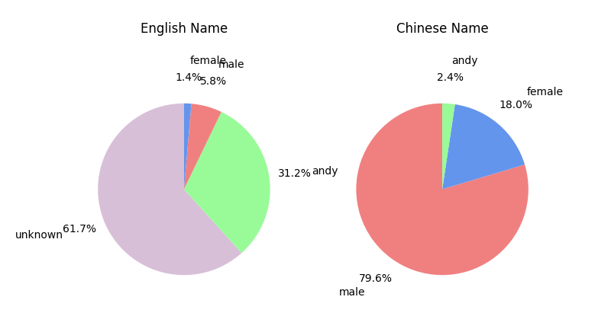
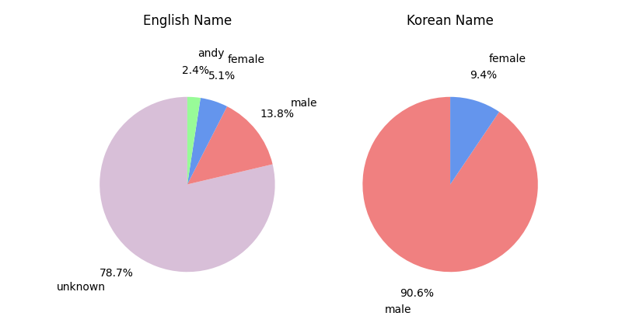
Visualizations and Graphs
Comparing predictions based on original and translated names, the method based on original names gives better results.
Notes:
Results of your analyses
Try to present results in the form of visualizations and graphs as much as possible

Slide 5
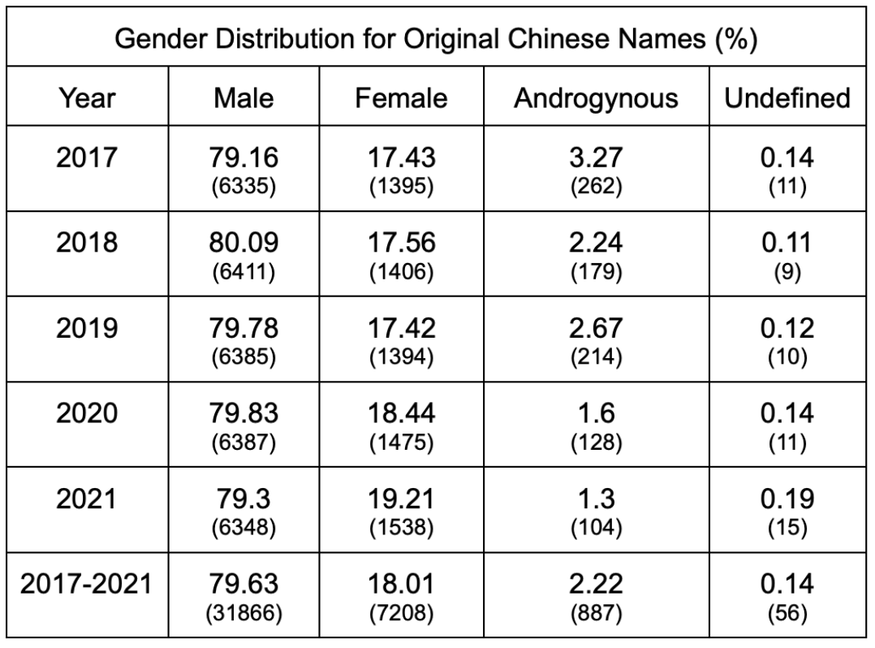
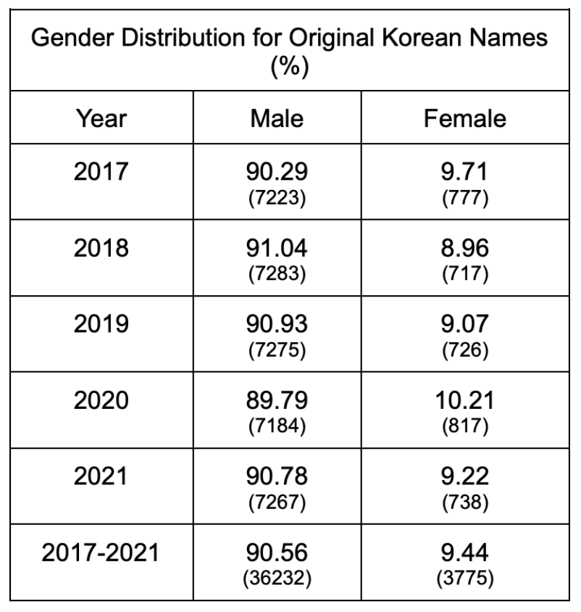
Visualizations and Graphs

Slide 6
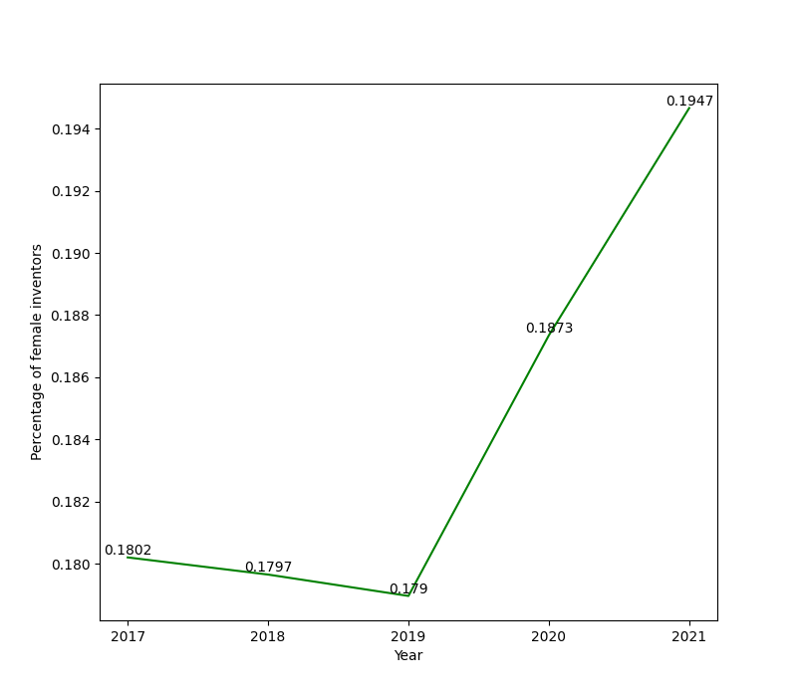

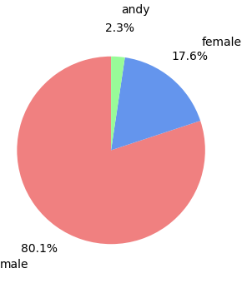
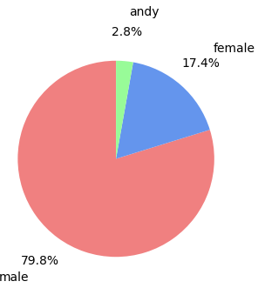
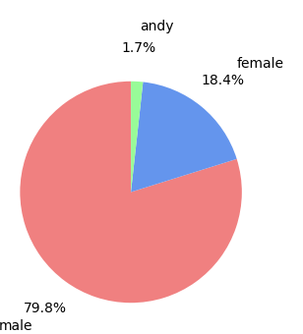
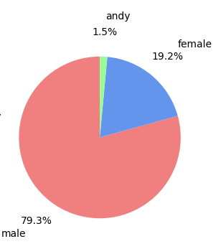
Visualizations and Graphs
Chinese Inventors
2017 2018 2019
2020 2021

Slide 7
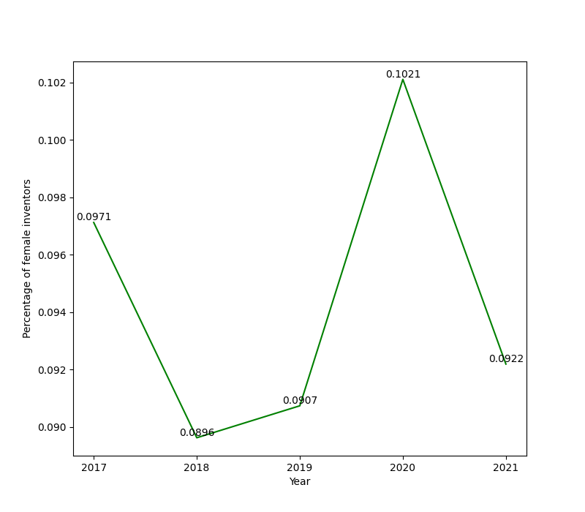

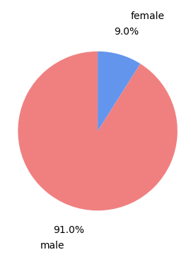



Visualizations and Graphs
Korean Inventors
2017 2018 2019
2020 2021

Slide 8
Conclusions & Moving Forward
Conclusions
Key Question 1: What is the difference between analyzing original characters instead of English translated names?
English translated -> andryogynous or unknown
Original character gender predictors have much higher accuracy ratings
Key Question 2: What is the gender distribution like among original character names?
80% male among Chinese inventors
90% male among Korean inventors
Key Takeaway: English translated names provide misleading gender distribution data
Limitations & Moving Forward
Real gender is unknown -> would be nice to compare for further accuracy
Not all Chinese and Korean patents from the USPTO dataset were crossmatched successfully to a corresponding Chinese or Korean version -> unrepresentative of the entire Chinese and Korean dataset
To keep processing times realistic, we only analyzed years 2017 - 2021 -> there could exist unseen trends from previous years
Notes:
Conclusions you were able to draw that relate to your goals
Possible next steps, further work

Slide 9
Q&A

